Slide 1
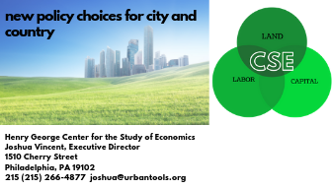
Using Land Value Tax to Revitalize Urban Land Markets and Assist Smart Growth
Tuesday January 29, 2019
University of Pennsylvania
Using tax policy and fiscal incentives as complements to governance in a revenue-scarce environment.
Joshua Vincent
Center for the Study of Economics
1501 Cherry Street
Office: 215-266-4877
Email: Joshua@urbantools.org
www.urbantoolsconsult.org
Notes:
You heard about the land value tax in this panel to achieve particular goals. In this segment, I like to briefly explain how the property tax works, how it can work in , be a powerful planning tool and address specific project and funding goals.

Slide 2
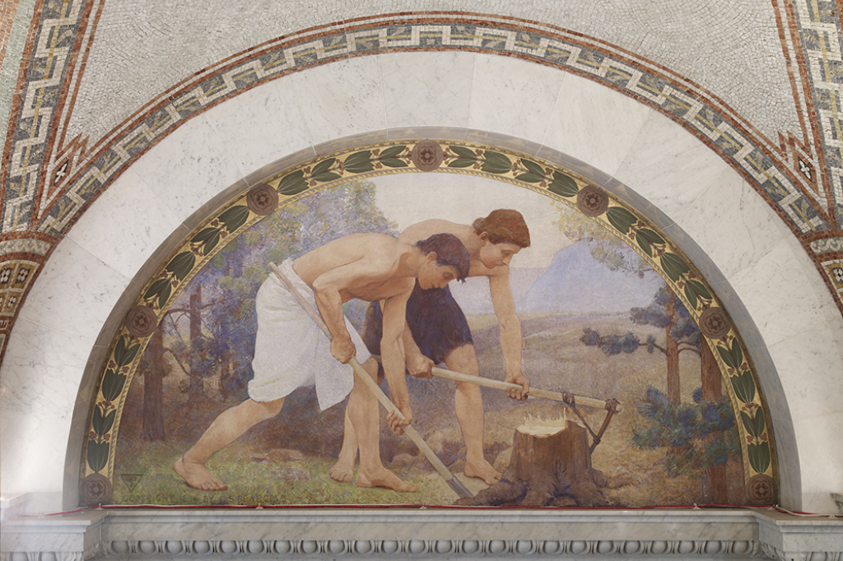

What Makes Our World?
Labor: Our Work

Slide 3


What Makes Our World?
Capital: In economics, "capital" refers to productive inputs that are (1) produced and (2) provide an ongoing stream of productive services. The fact that capital is produced distinguishes it from land and other natural resources, which are supplied by nature.

Slide 4
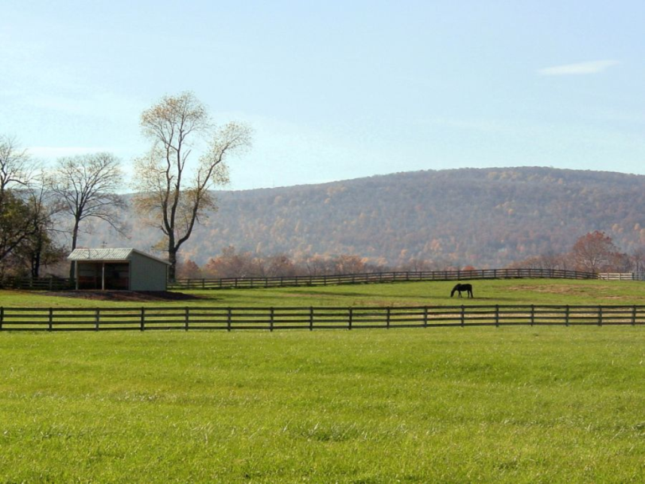
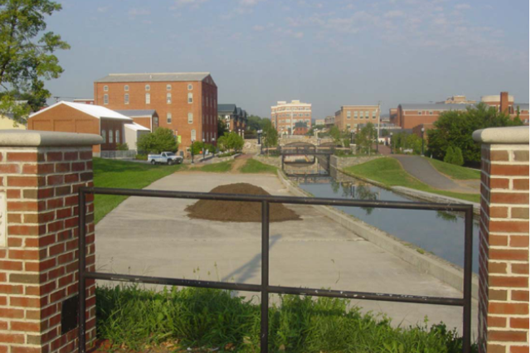
What Makes Our World?
Land: The Earth we stand on, the air we breathe, the water we drink, the place we need to exist.

Slide 5
Three Things Make Our World
Two act very differently, and they have an impact on our cities and communities:
Labor is mobile, it moves to where it is rewarded most.
Capital is mobile, it moves where it can be used most profitably.
Land is different: It is immobile.

Slide 6
What Tax Makes Sense or is Progressive?
Name the “Good” Tax
Sales Tax -Mobile
Income Tax - Mobile
Business Taxation - Mobile
Real Property Tax – Half Mobile
Most Regressive.
In Philly, regressive: high rate (7%) at 1st $1 of wage. Wages are mobile, Texas anyone?
Regressive, it hits new and small business hard, and neighborhood harder.
Regressive as used today…

Slide 7

Most Methods of Revenue/Taxation: Self-Defeating

Slide 8
What is Land Value Taxation?
A tax on land, and no tax on buildings
Public (Tax) Policy
Project-driver:
Infrastructure
Value Capture
Market Investment
Sweat Equity
Model of:
Tax Efficiency
Economic Efficiency
Cost Efficiency
Notes:
Can be revenue neutral so it does not lose revenue for the municipality.
A lower (or no) mill rate is placed on buildings, improvements, and maintenance to incentivize construction, investment, and upkeep. Utilizes current real estate assessments so it is easy to implement and there is no growing of government.

Slide 9
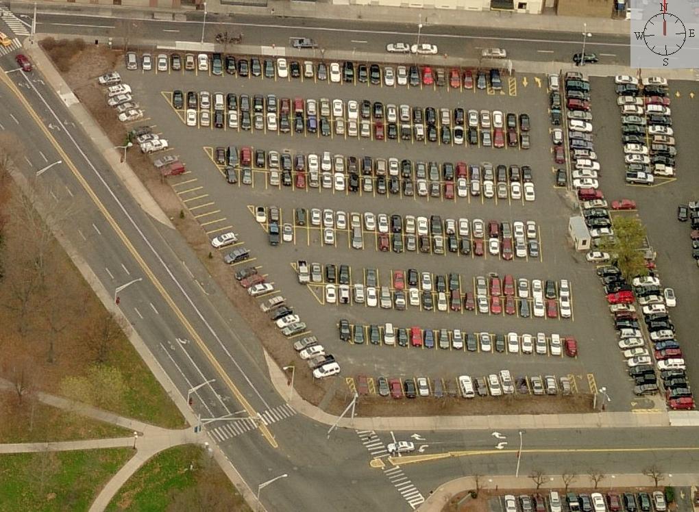
LVT Creates a supportive environment for investment:
Hartford Central Business District
Hartford: Surface Parking Lot
$4.5M
Rise in holding cost incentivizes land owner to build or sell
Decrease in tax bill allows builder/developer to capitalize savings into selling price allowing for higher profit per unit or ability to sell units for less resulting in more units sold
$1.01M
$1.01M
Annual
Tax Bill
$193K
Land Value
$2.7M
Building Value $50M
Traditional @ 74.29 mill tax rate
LVT @ 393 mill tax rate land
Notes:
I checked, and the mill rate is still 74.29 in Hartford. 10 Front Street, with projected value of $50 Million for new construction

Slide 10
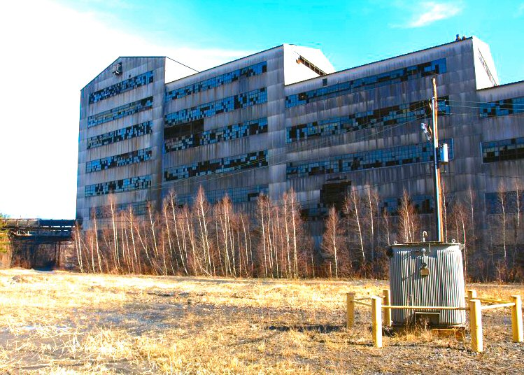
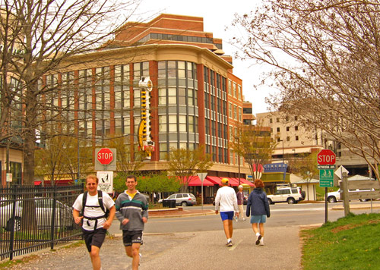
LVT Advantage for Planners
Increases investment & incentivizes owner upkeep in neighborhoods and downtowns.
Supports Smart Growth objectives, relieving development pressure on exurbs.
Protects historic districts by preserving the identity and character of the built environment.

Slide 11
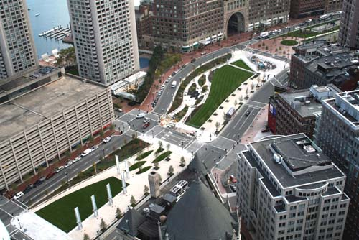
Uplift in site values through government policy
Diving Into the Big Dig: As the Boston Globe reported in 2004, commercial properties (land) along the Old Artery increased in value by 79 percent in 15 years, nearly double the citywide increase of 41 percent. How to get back that public value?

Slide 12
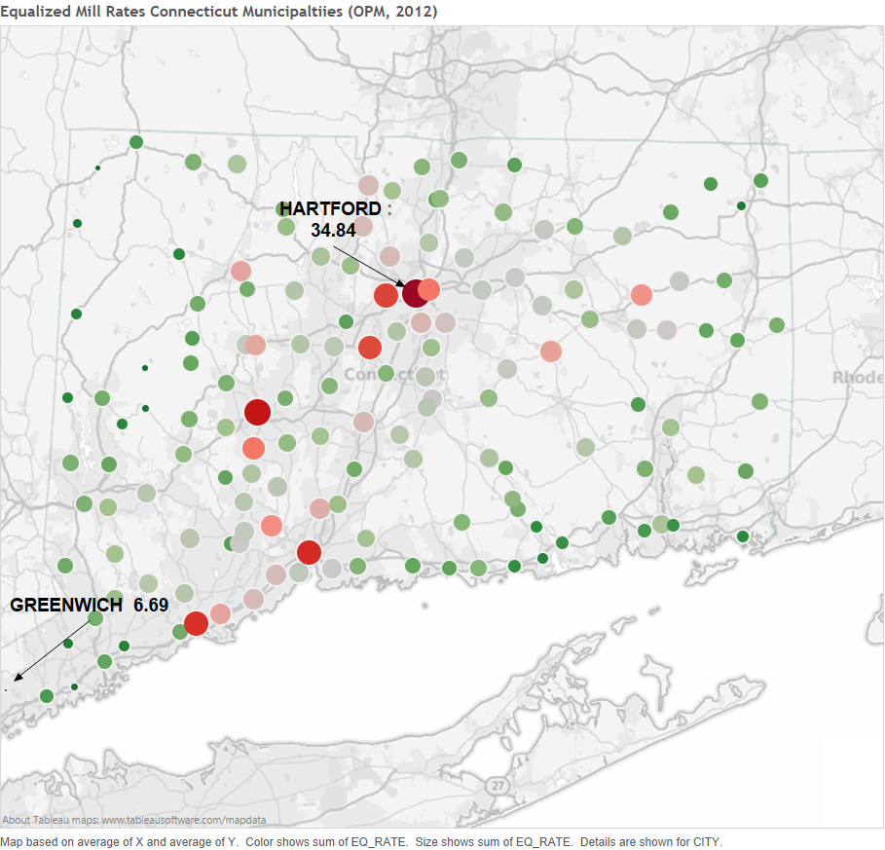
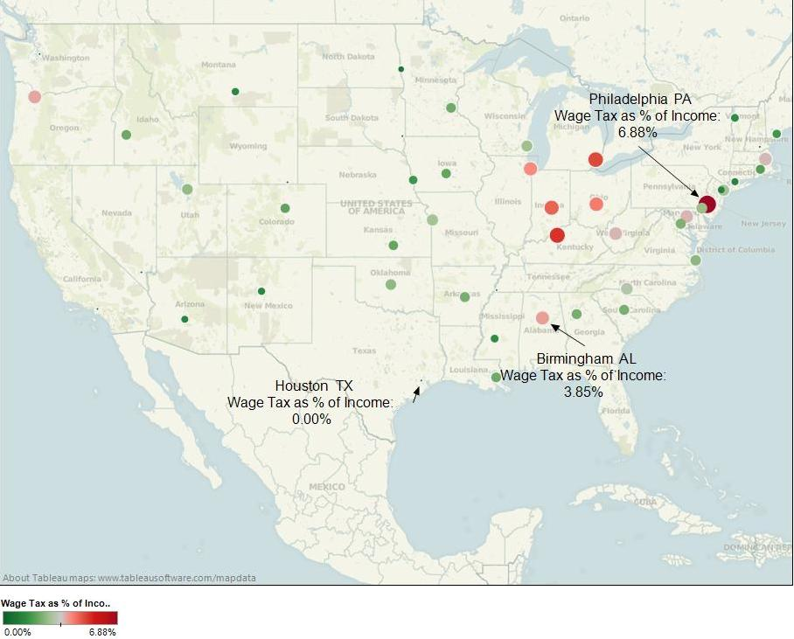
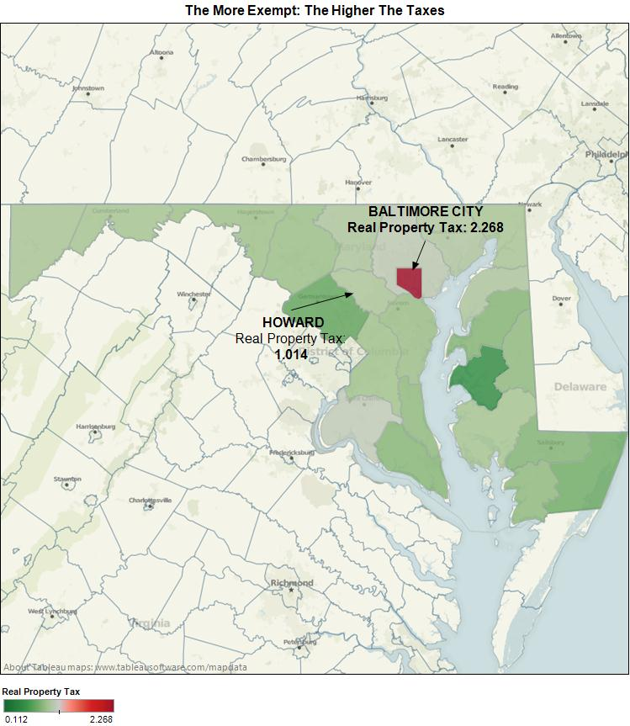
How can This be Shown?

Slide 13
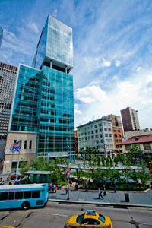
Other Methods of LVT
The need for a BID is often caused by vacant or blighted lots. LVT in a BID puts burden on owners that cause the problem.
Business Improvement District
Primary Revenue Source: Land Value
Operational Purpose
Lot Maintenance
Pittsburgh Downtown Partnership
$1.4 M
Street & Walk Cleaning
39% of Budget
Notes:
Pittsburgh Downtown Partnership http://www.downtownpittsburgh.com/
BID Assessment
Q: What is the BID tax?
A: In 1997 the business improvement district [BID] was established under a five-year sunset clause approved by Pittsburgh City Council. Through the BID, property owners within the Golden Triangle are assessed to pay for services, provided by the PDP, that directly benefit Downtown such as cleaning, safety, marketing, and transportation initiatives. In 2006 and 2011, Pittsburgh City Council unanimously renewed the BID levy for another five years. The PDP manages the BID.
Q: When is the BID tax due?
A: The Business Improvement District assessment is paid once each year. The due date varies according to when the City of Pittsburgh generates the tax notices. It is generally due February 28.
Q: How do I know if my property's BID tax has been paid?
A: Contact Robyn Williams, VP of Finance, at (412) 566-4190 orrwilliams@DowntownPittsburgh.com.
For more information on the calculation of BID assessments, please review this information.

Slide 14
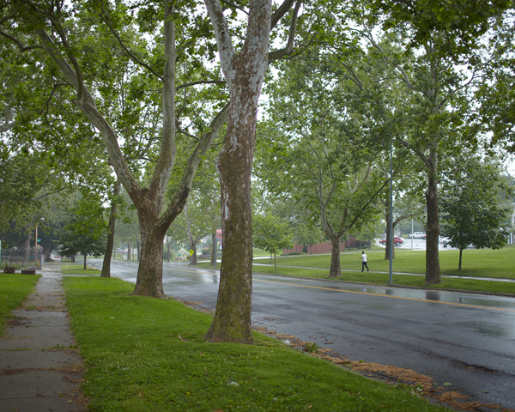
Other Methods of LVT
Parks and Greenways provide public benefit to proximate landowners.
Kansas City, MO Parks, and Boulevards Levy collects from those beneficiaries.
Benefit has a cost.
Kansas City, MO
Revenue: Land Value
Purpose: Maintenance of the City Plan
Parks and Boulevards System, planned and built 1890s - 1940s
Boulevard Tax currently $1.00/ft, and generates $600,000
Parkway Maintenance Tax levied on Land-Only, generates $6.6 million a year
Notes:
Kansas City, Missouri uses land value tax specifically for a benefits received policy: each parcel adjoining the parks and boulevards pays relative to proximity. Assessors determine the “benefits received” in land value. Less proximate parcels pay less. http://www.asce.org/People-and-Projects/Projects/Landmarks/Kansas-City-Park-and-Boulevard-System/

Slide 15
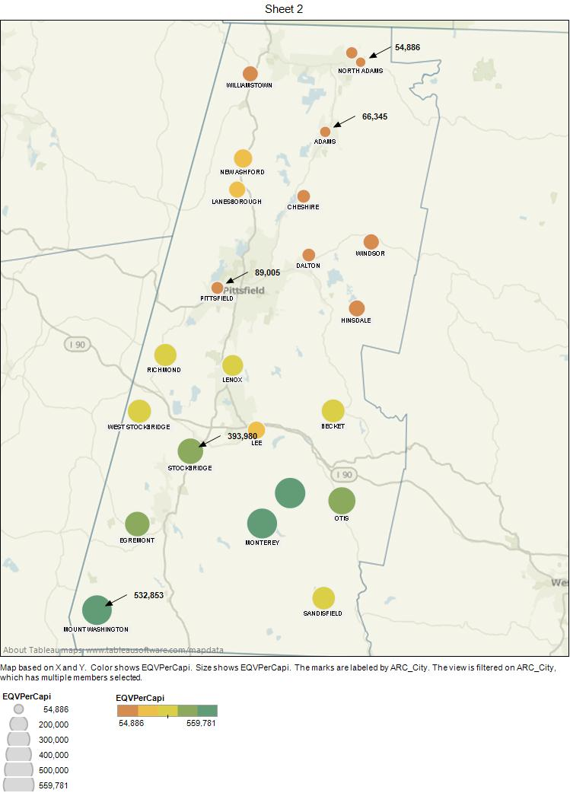
Other uses for LVT
Regional Tax Base Sharing
Revenue: Land Value
Purpose: Broad-based economic benefit
Berkshire County MA: Stark Division of Poverty and Wealth
A regional LVT shares benefits created by state and local investment
Wealthier towns assist but are not dragged down economically.
Notes:
The idea of tax base sharing (TBS) has been put forward for decades by policy makers, but almost totally rejected at the governmental level due to concerns that local economies will suffer through assistance to less prosperous ones. By basing the TBS on taxable land values, the core of a strong town economy (jobs, business) is not affected. The poorer towns using LVT can contribute more to the region as growth returns and finances stabilize. This slide uses 2012 Mass. Department of Revenue equalized taxable values as an example of how a TBS based on LVT could work.

Slide 16
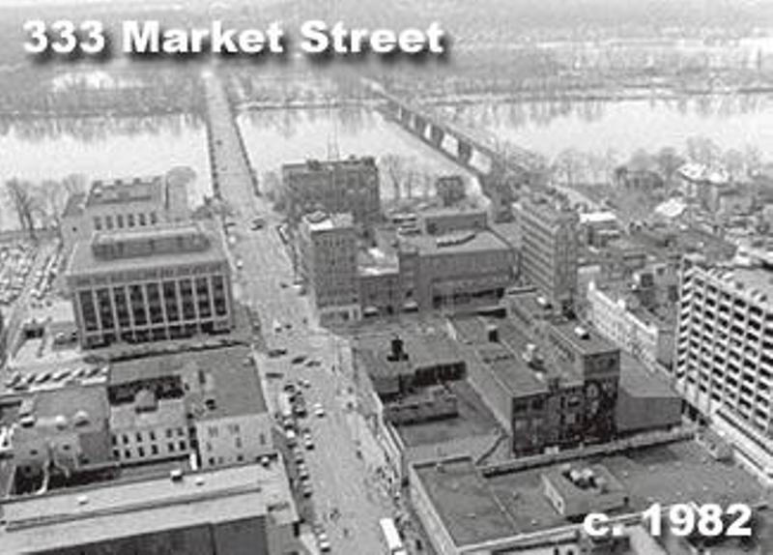
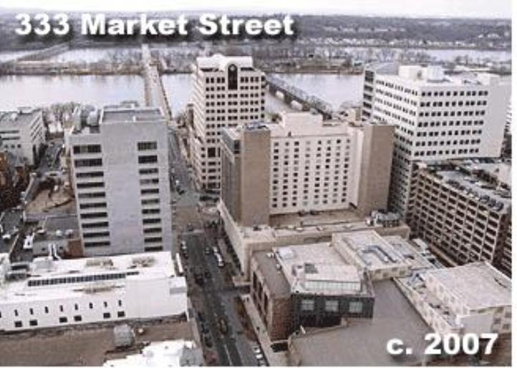
Harrisburg, PA
Early LVT
Late LVT
Notes:
Examples of Harrisburg commercial success.

Slide 17
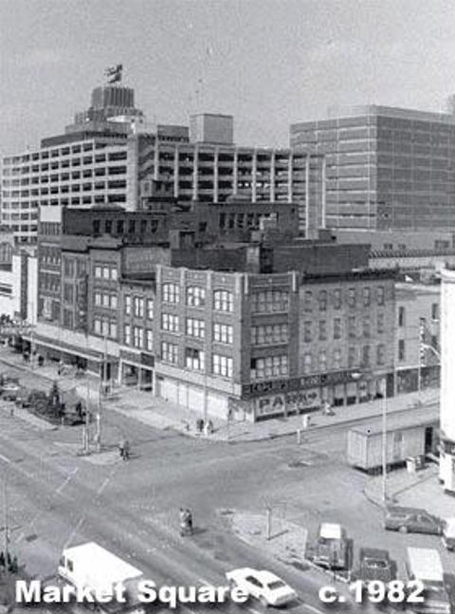
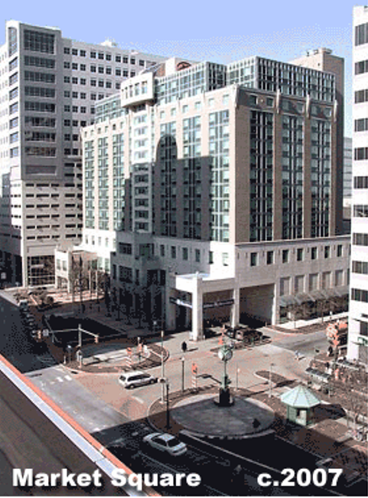
Harrisburg, PA
Early LVT
Late LVT
Notes:
During the recent confrontation with a bankrupt incinerator project, and huge debts; the city of Harrisburg was presented with a plan to pay off bondholders, with such provisions as reducing services, increasing total taxes, and rescinding the land value tax, along with a adding an abatement for all new commercial construction. Citizens, elected officials and our Center all banded together to reject loss of LVT. The control panel for the city backed down

Slide 18
What happens with LVT?
Harrisburg Expands LVT
Notes:
Some of the latest research CSE has done is based on taxable residential building permits. Here, Harrisburg is compared to an analog city, Albany, NY. After the last significant shift in 2003, the succeeding years showed an unmistakable and statistically significant increase, measured by the raw data and a linear progression for both cities.

Slide 19

Do Markets Change to Assist Planning?
Classic LVT Study: Oates and Schwab, 1997
Notes:
The most widely known economic study of the effect of land value taxation was written by Robert Schwab and Wallace Oates in the 1990s. The empirical results of their building permit issuance study is presented in a map, prepared by CSE. Construction in Pittsburgh, even in the era of industrial contraction, leapt ahead of its Rust Belt analog cities. http://www.lincolninst.edu/subcenters/property-valuation-and-taxation-library/dl/oates_schwab.pdf during the Renaissance II Project
Conversely, when LVT was rescinded in 2000, taxable building permits in Pittsburgh dropped 21% as the nation entered a period of prolonged construction. http://urbantools.org/IT/2003/incentive-taxation-2003.06.pdf/view

Slide 20
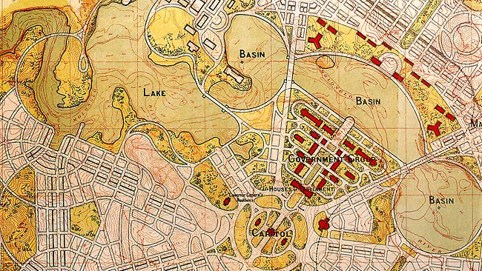
Mega Ultra Example of Land Values and cities: Canberra

Slide 21
Mega Ultra Example of Site Value and Planning: Canberra and Walter Burley Griffin
I do not, however, fail to recognize that yours is the greatest opportunity the word has afforded for the expression of the great democratic civic ideal. Your advantages are not only in the characteristic Australian idealism and interest in Government activity, but in the fundamental land policy of the Capital.
This, at the outset, when you have only a population of 25,000, would, on the basis of average American city land values ($1,000 to.$1,500 per head), lead me to predict for the Federal Capital an annual income from land rentals of £250,000 to £300,000 per year. without taking account of any property taxes or profits from Public Service operations. [$40 Million Australian 2018]
The fiscal side is not the strongest phase either, because, freed from land speculative selfish interest the natural instincts of the community will guarantee higher artistic and seasonal standards, as already instanced by one at the city site, an attitude of fear of spoiling the landscape, such as is not at all to be found in "boom" towns.

